Slide 1
Config 1
SCP v6.21
  6 nodes
  1 value
  2 quorums
  inf 5
  gap 1

Slide 2
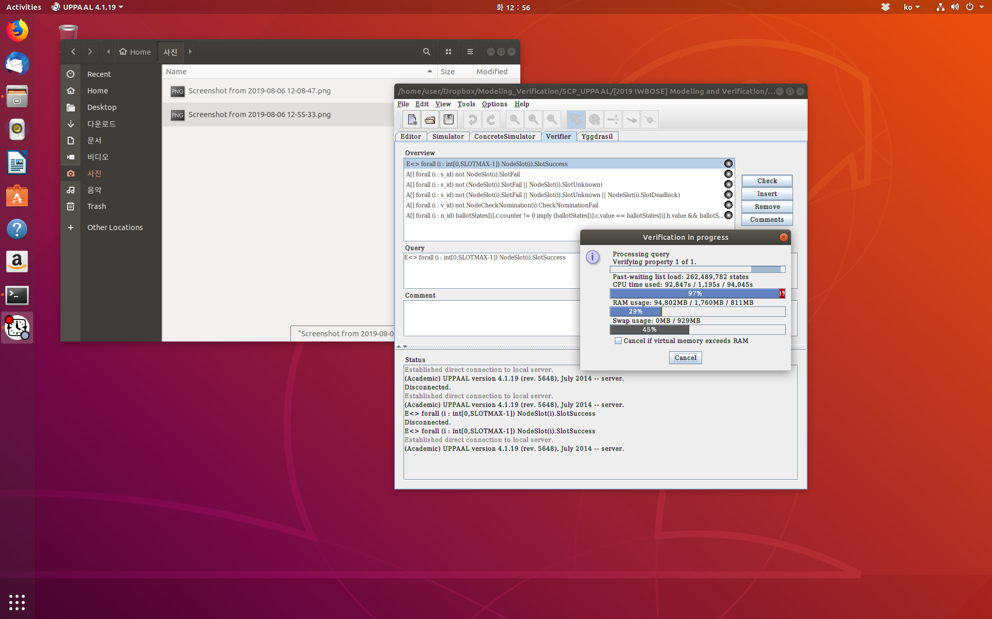

Slide 3
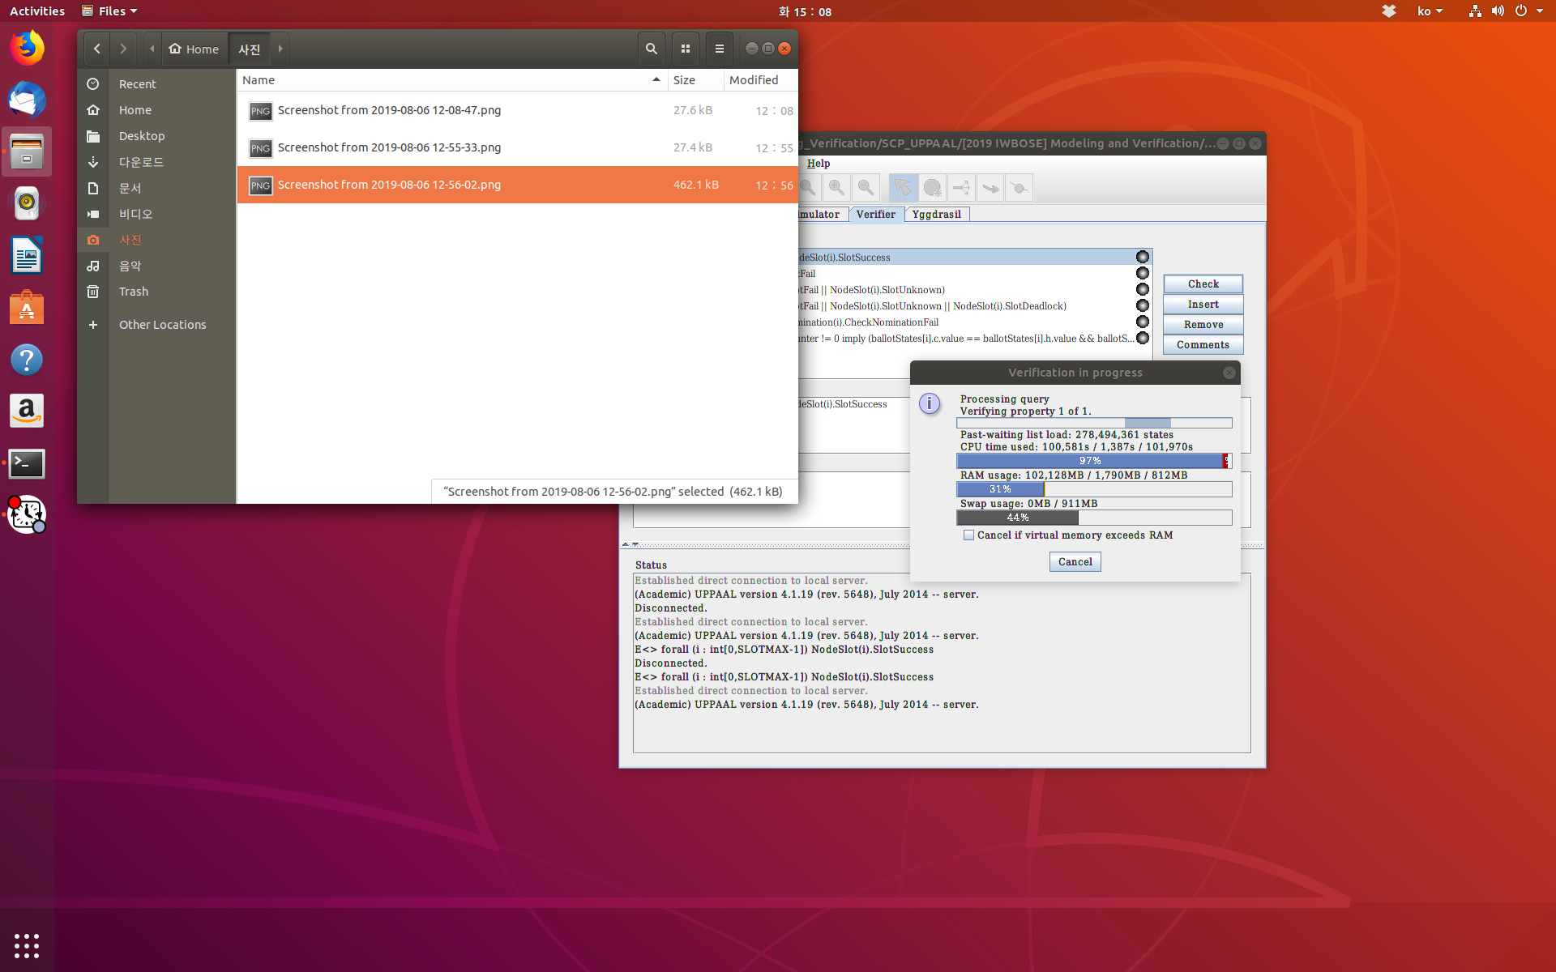

Slide 4
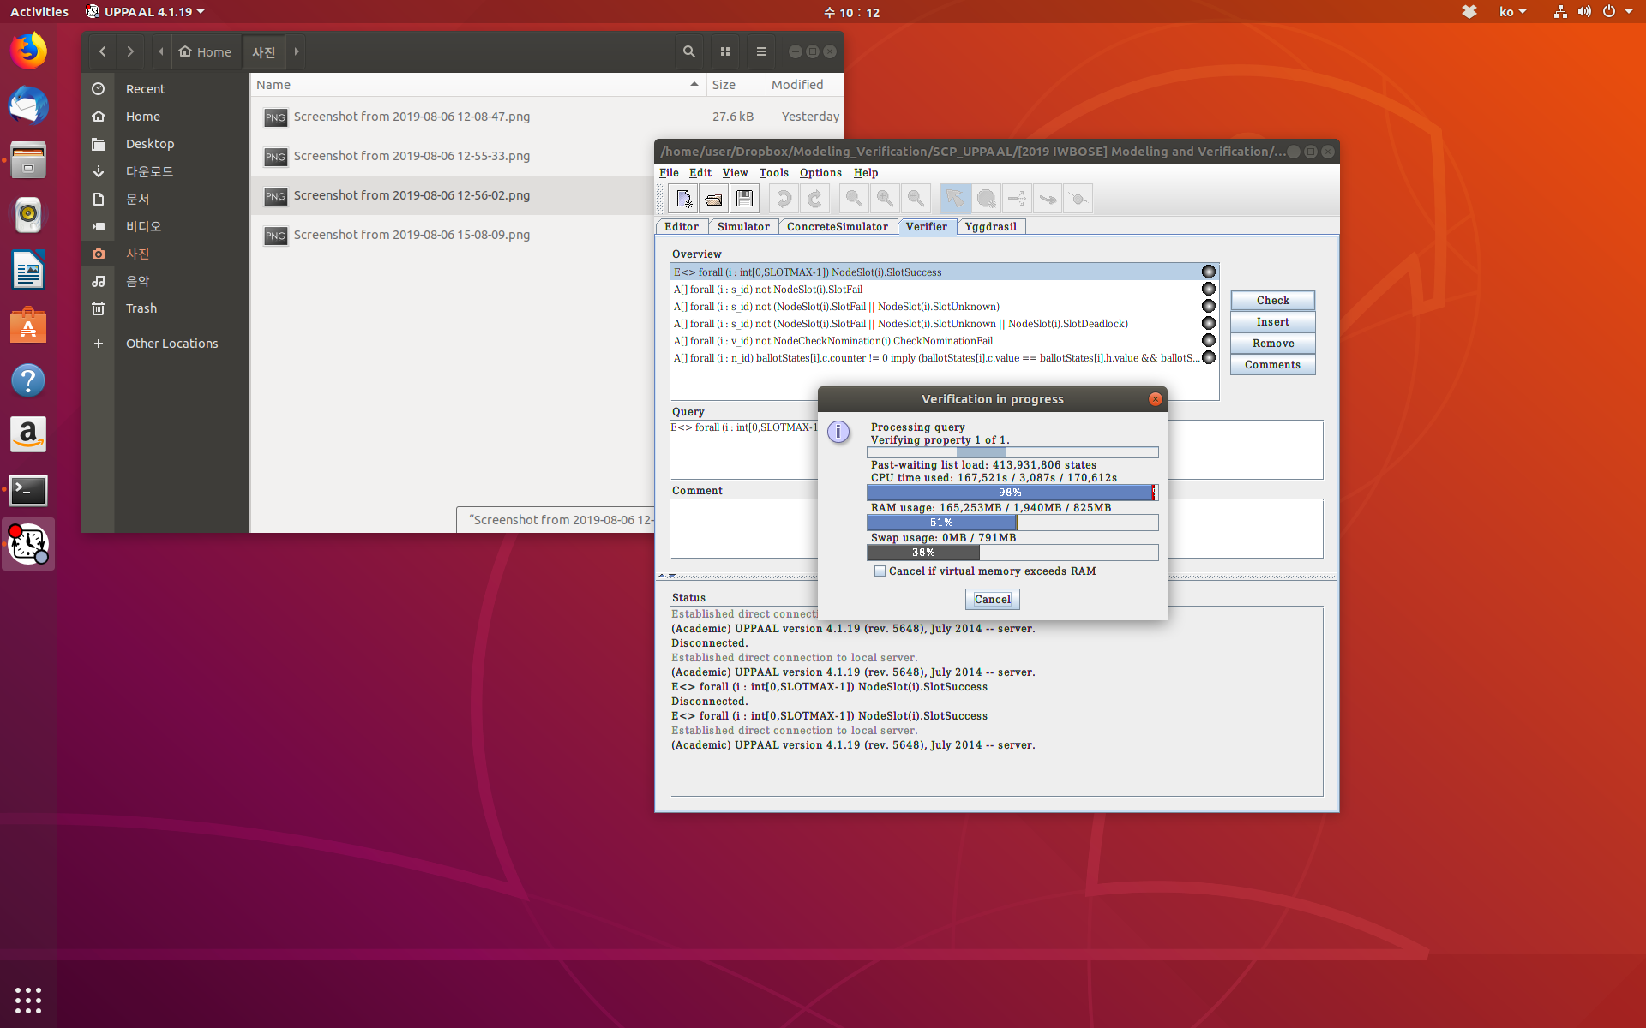

Slide 5


Slide 6
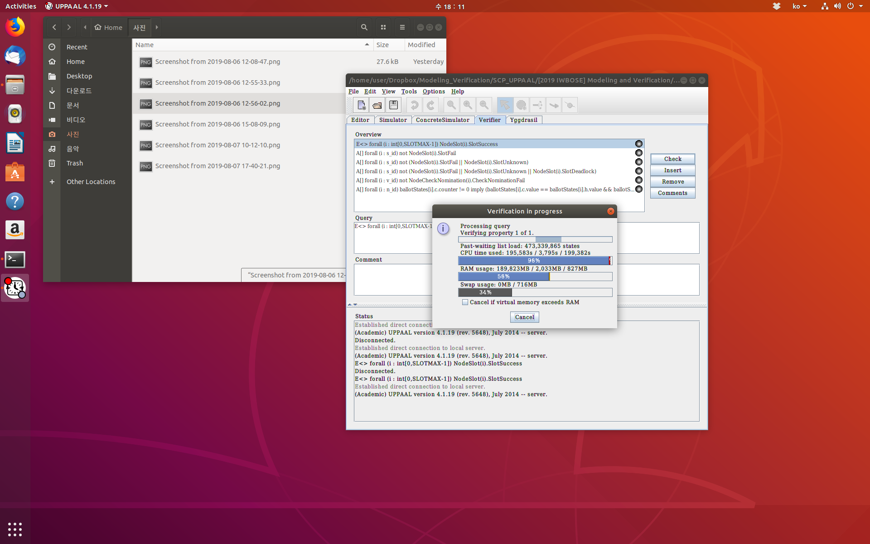

Slide 7
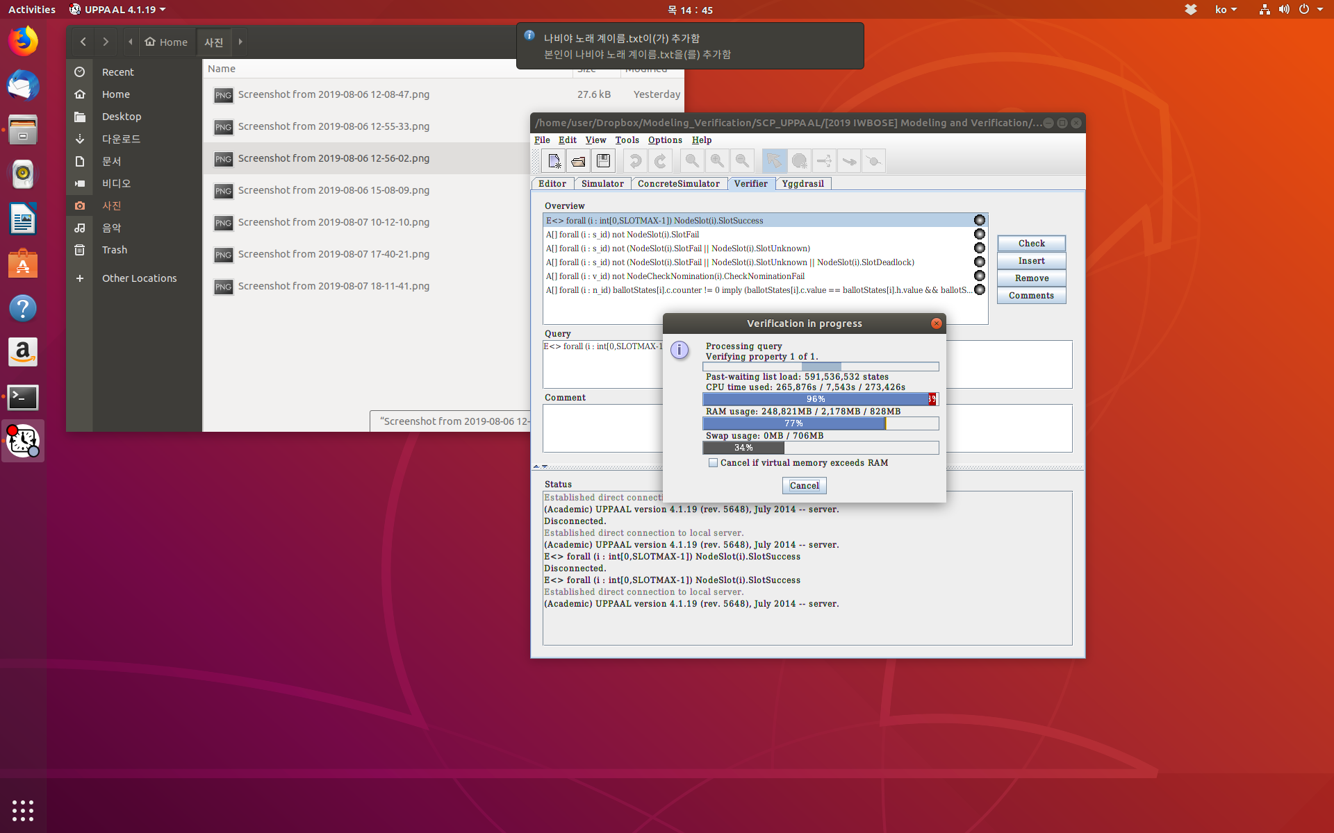

Slide 8
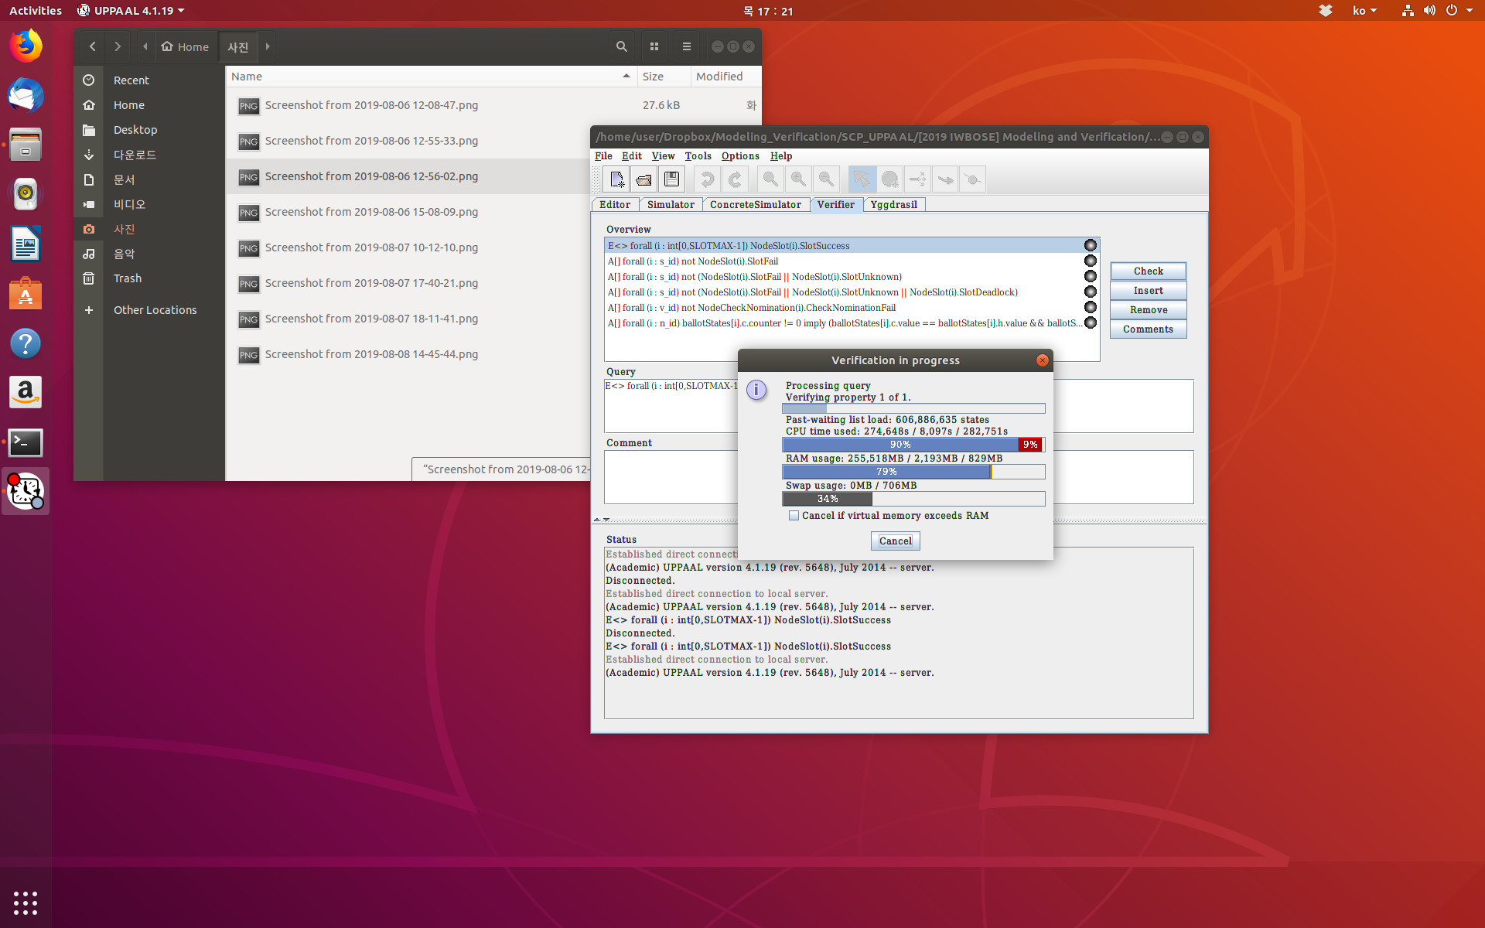

Slide 9
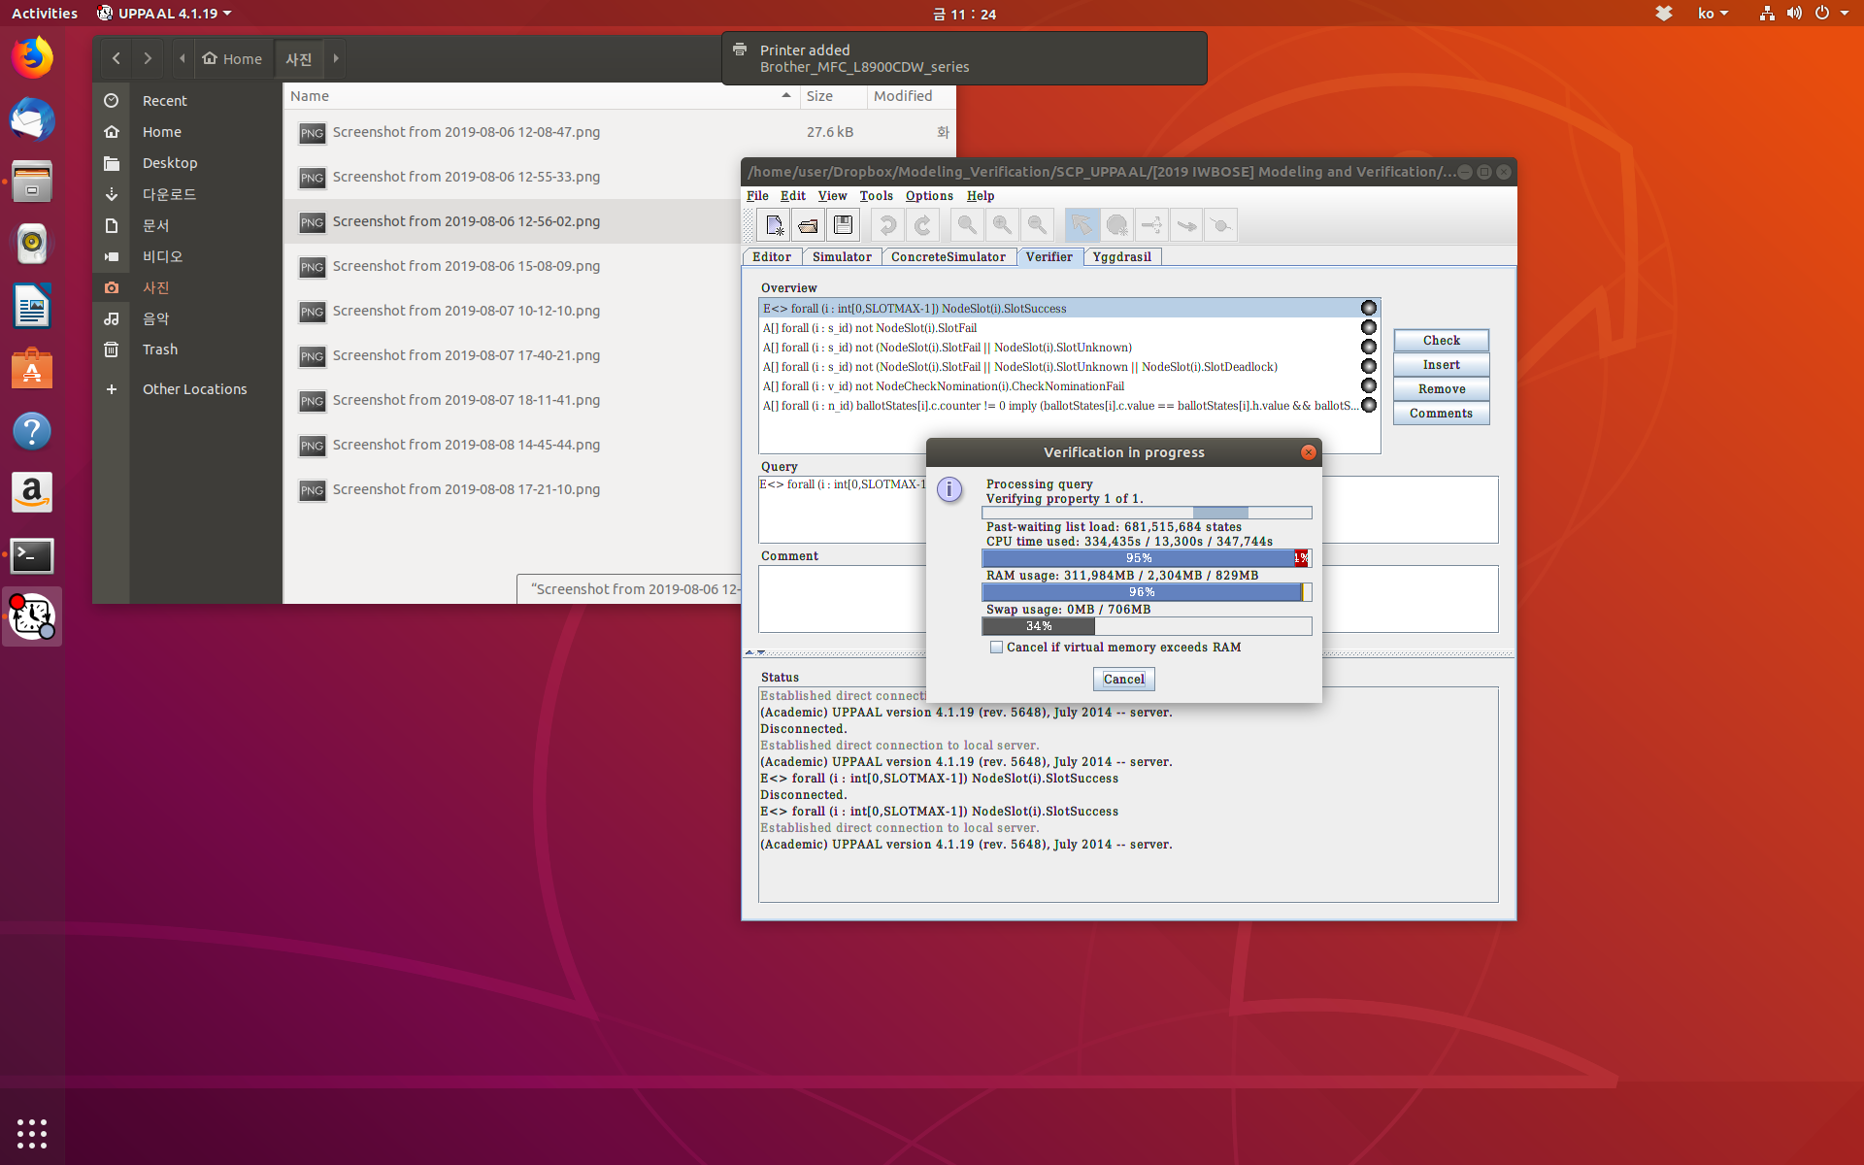

Slide 10
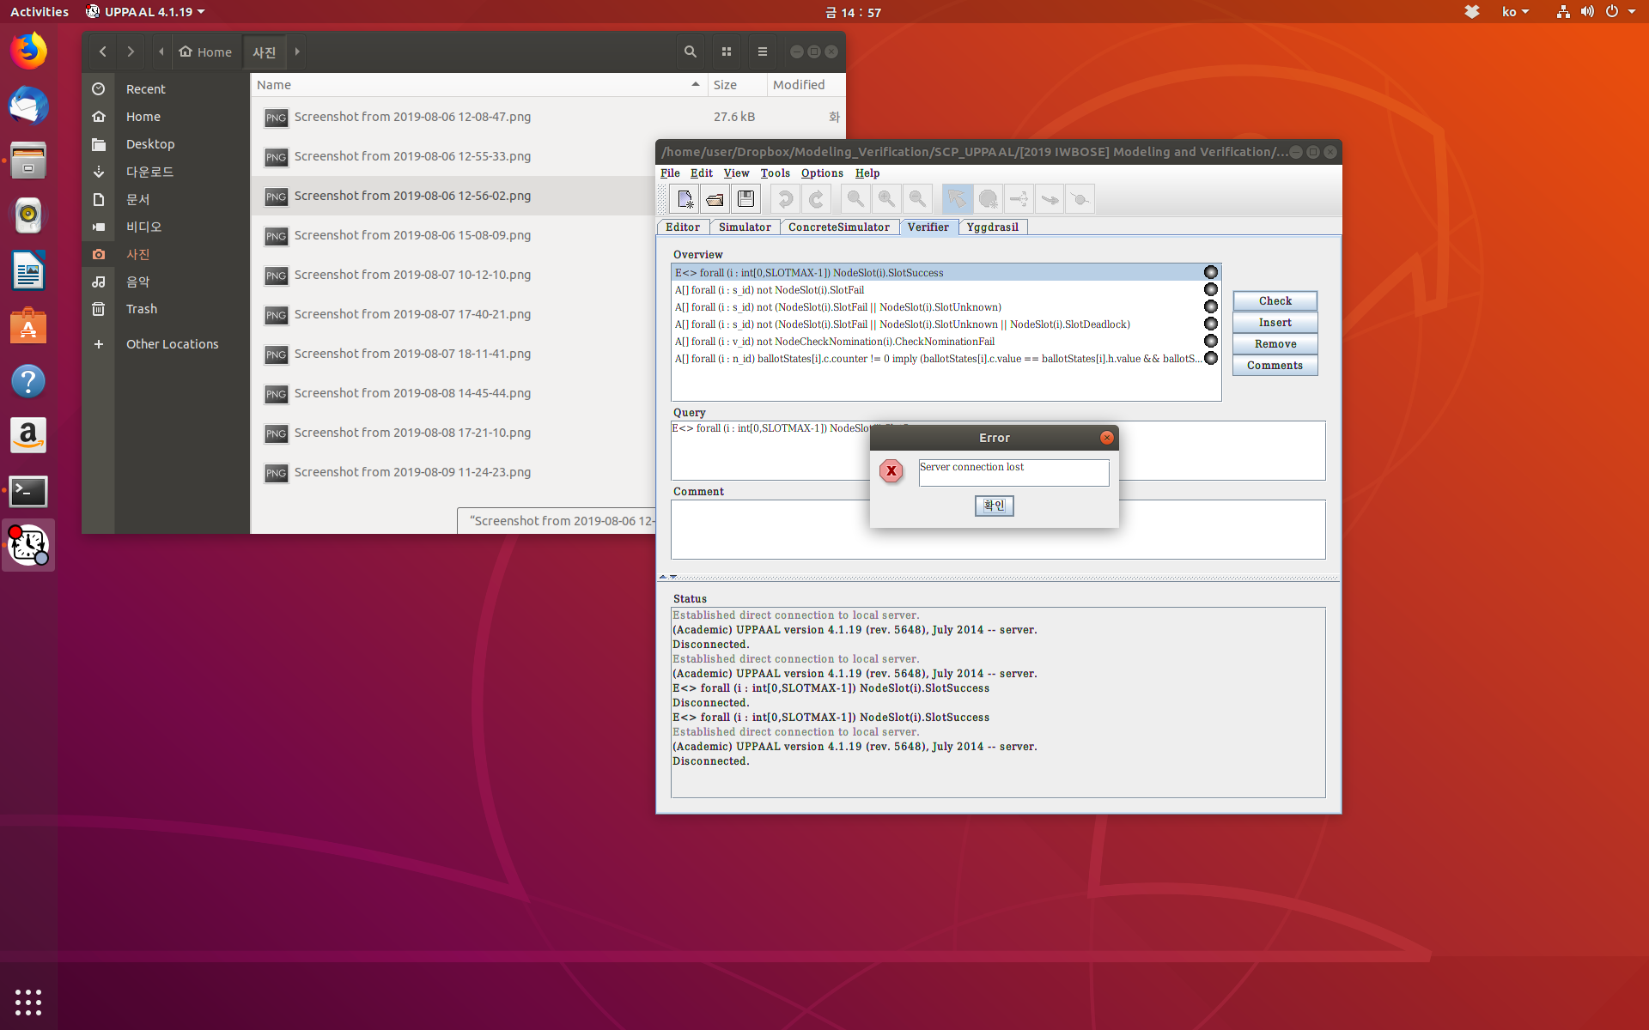

Slide 11
Config 2
SCP v6.21
  6 nodes
  1 value
  1 quorum
  inf 5
  gap 1

Slide 12
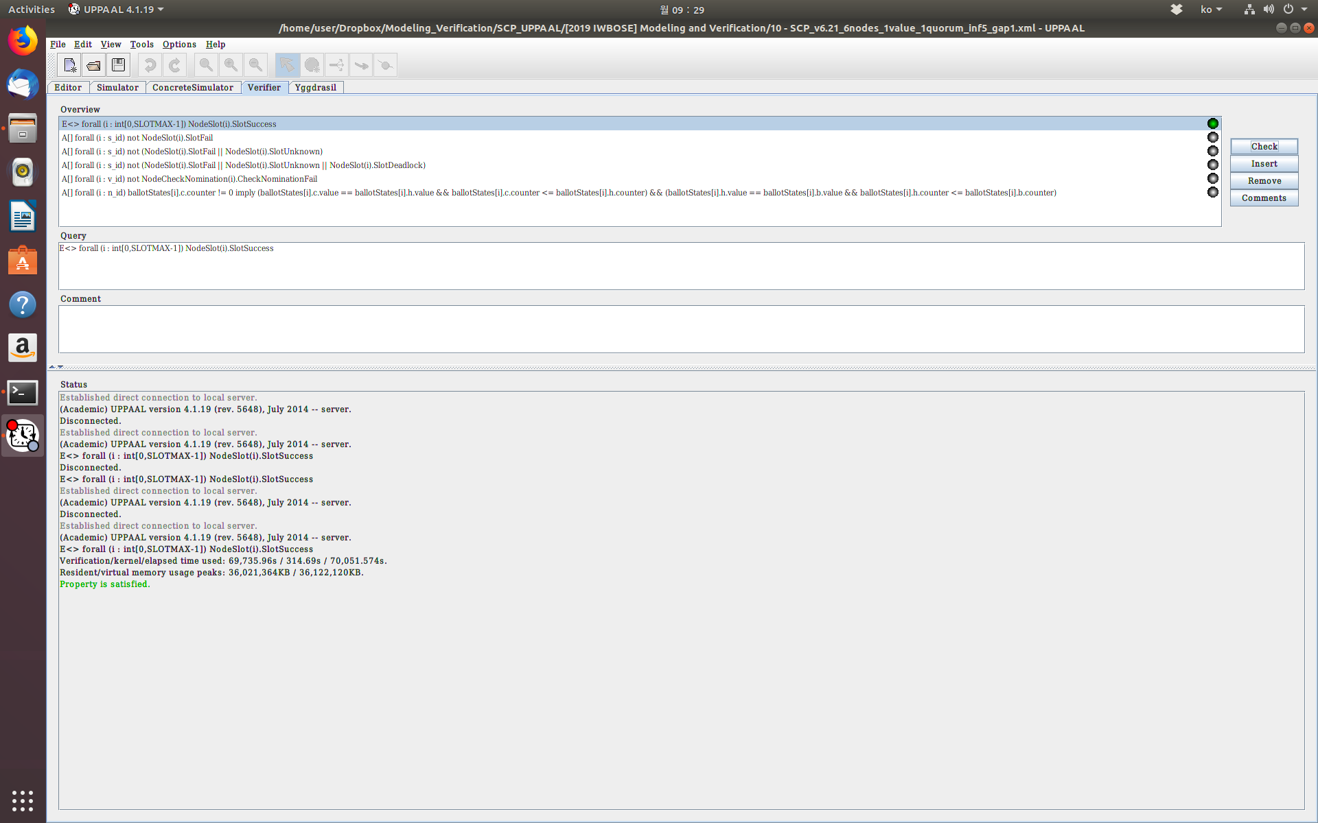

Slide 13
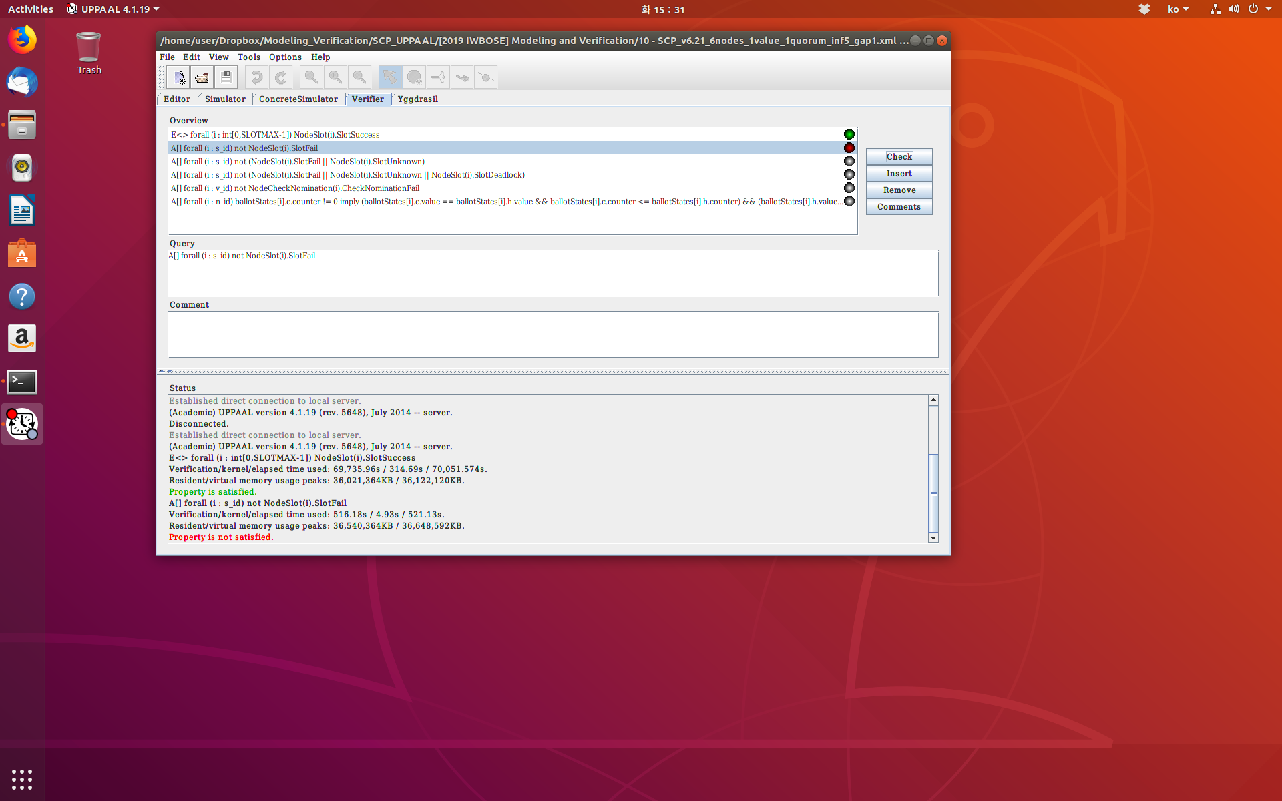

Slide 14
Config 3
SCP v6.21
  6 nodes
  1 value
  1 quorum
  inf 10
  gap 1

Slide 15
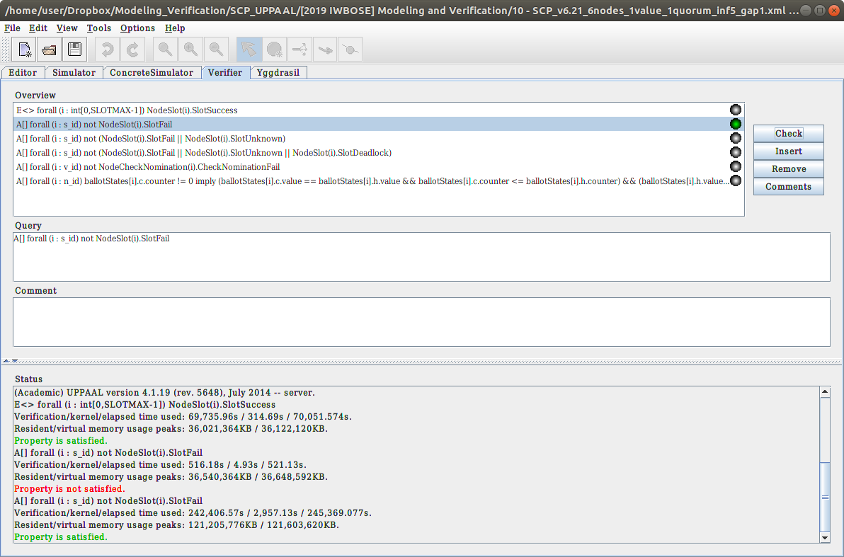
inf10
inf5
inf10

Slide 16
Config 4
SCP v6.21
  6 nodes
  1 value
  1 quorum
  inf 9
  gap 1

Slide 17
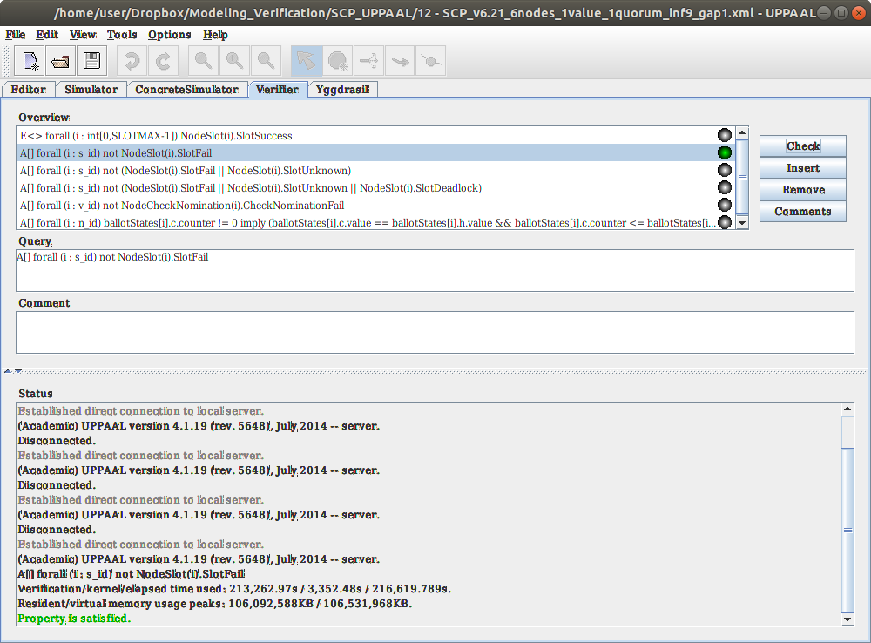

Slide 18
Config 5
SCP v6.21
  6 nodes
  1 value
  1 quorum
  inf 8
  gap 1

Slide 19
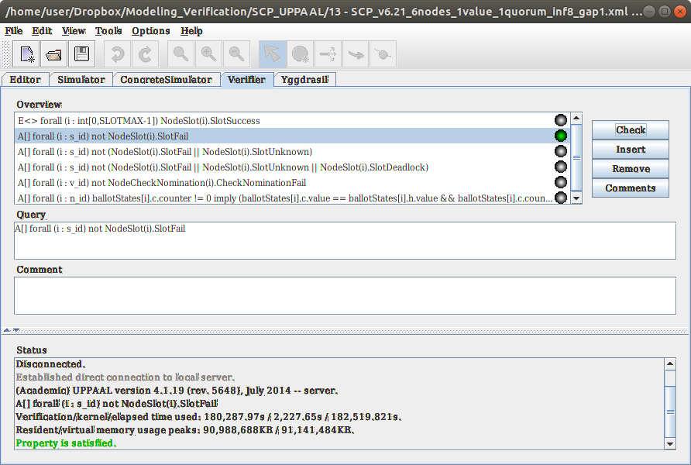

Slide 20
Config 6
SCP v6.21
  6 nodes
  1 value
  1 quorum
  inf 7
  gap 1

Slide 21


Slide 22
Config 7
SCP v6.21
  6 nodes
  1 value
  1 quorum
  inf 6
  gap 1

Slide 23
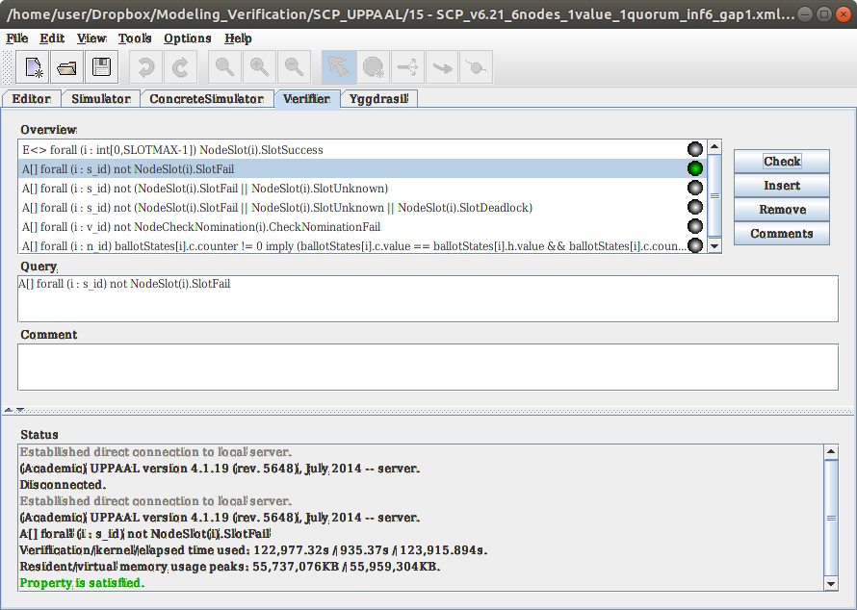

Slide 24
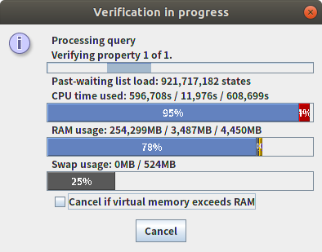
Config 8
SCP v6.21
7 nodes
1 value
1 quorum
cnt 6
gap 1
Crashed(?) with no messages

Slide 25
Config 9
SCP v6.22
6 nodes
1 value
2 quorum
cnt 6
gap 1

Slide 26
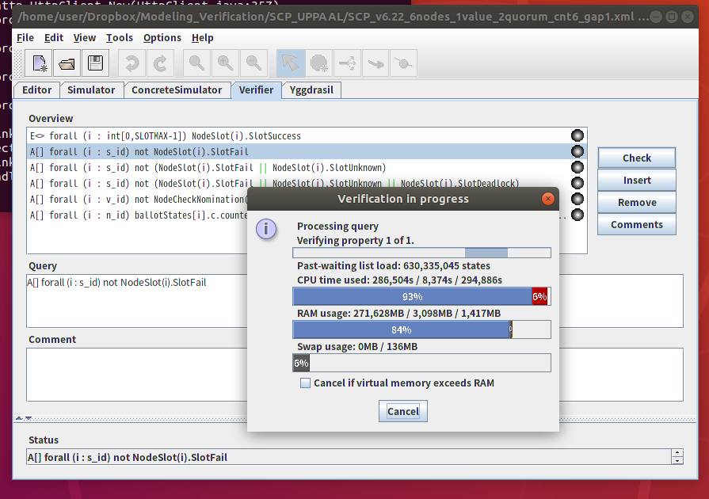
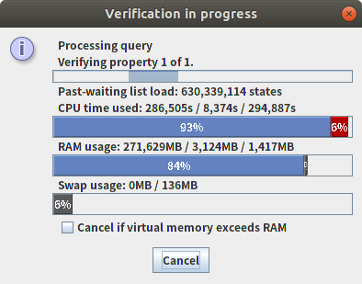
Crashed(?) with no messages

